Slide 1



Final Pitch Deck
Practical and Social Challenges for International Students at University of Melbourne
Group E
INFO90010 – Technology Innovation Project

Slide 2





UniConnect: Group E | Technology Innovation Project
Empowering International Student Success at the University of Melbourne
How we designed a solution rooted in real user needs
A mobile-first platform that empowers international students to thrive. provides a seamless access to essential information, facilitate meaningful social connections and deliver personalized academic planning tool all through a gamified experience
What is UniConnect?
Key Challenges for International Students
Gamification: XP Points, rewards and progression!
Insights Engine: AI Powered Informational System
Build on Real Insights
Built to enhance belonging, clarity and confidence
Primary Research
1
Difficulty finding suitable accommodation
15 semi structured interviews with UniMelb international students
1
Suburb Insight
The Problem
Struggles in building meaningful connections
Neighborhood data, culture fit, reviews
Our Validation
2
Secondary Research
Our Solution
Group Finder
3
Confusion navigating academic systems
Literature on social integration, acculturation stress and academic performance
3
Join/create study groups by subject or location
Opportunity: A high-value, undeserved segment needing centralized support
Study Planner
Strengthen the validity of our findings
Career-aligned academic planning
Translating existing research into commercially viable innovation solution
Each interaction earns XP point, allowing students to earn rewards and level up their engagement
AI-powered insights system that delivers smart, contextual recommendations

Slide 3

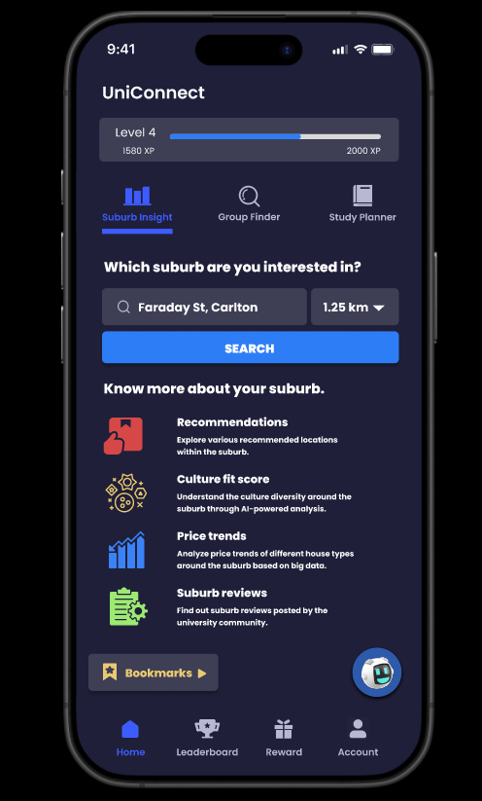




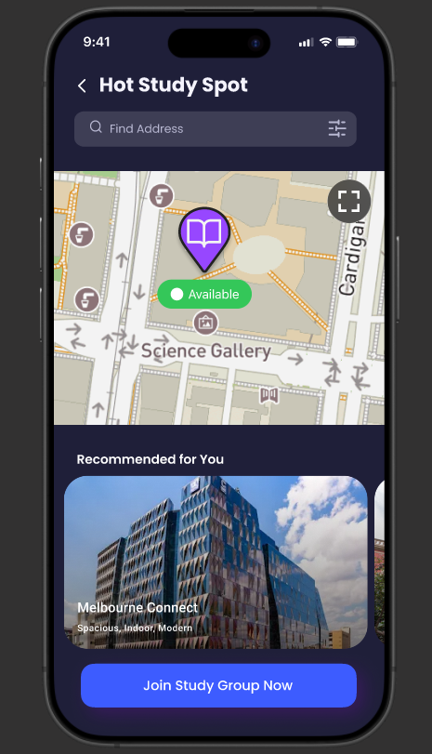




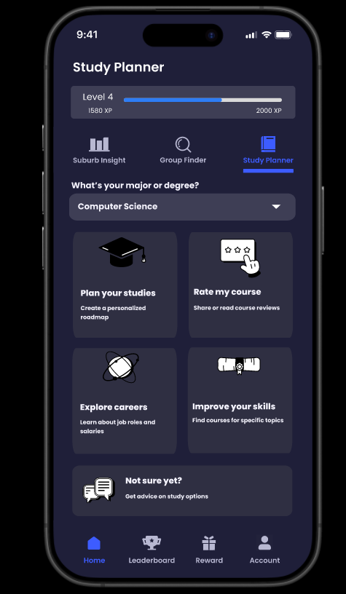



UniConnect: Who are our users?
International Students at the University of Melbourne Facing Practical and Social Barriers
Persona
Pain Points
Use Case Journey
Opens Suburb Insight
Difficulty finding housing that matches budget and lifestyle
1
Opens Suburb Insight
2
Uses Recommendations, Culture Fit Score and Price Trend to compare suburbs based on diversity and reviews
Opens Suburb Insight
Wastes time on misleading listings
Cameron Wang, 25
Lacks visibility into total cost (commute and day to day expenses)
Opens Suburb Insight
3
Confidently selects a location before searching rentals
Masters Degree in Business
Originally from Singapore
Hesitant to attend events alone
1
Opens Hot Study Spot under Group Finder
2
Uses location-aware map to join recommended study groups
b Insight
Feels socially disconnected
Ivan Petrov, 22
Opens Suburb Insight
3
Builds routine connection and campus familiarity through real-time group invites
Bachelor of Science
Needs lower-pressure ways to engage
Originally from Russia
1
Uses Study Planner to filter subjects by major and skills
Opens Suburb Insight
Unclear course-to-career alignment
Opens Suburb Insight
2
Builds roadmap and explores careers
Zong Dong, 28
Lacks motivation to plan academic roadmap
Attended external online courses to improve skills
Masters in Data Science
3
Opens Suburb Insight
Originally from Taiwan
Wants skill-based guidance
4
Earns XP & completes quests linked to personal growth

Slide 4

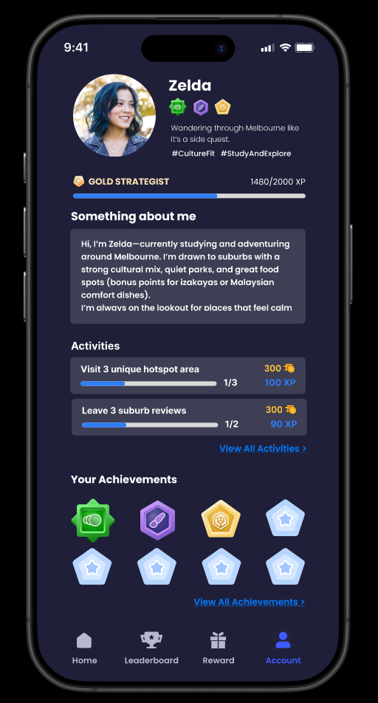
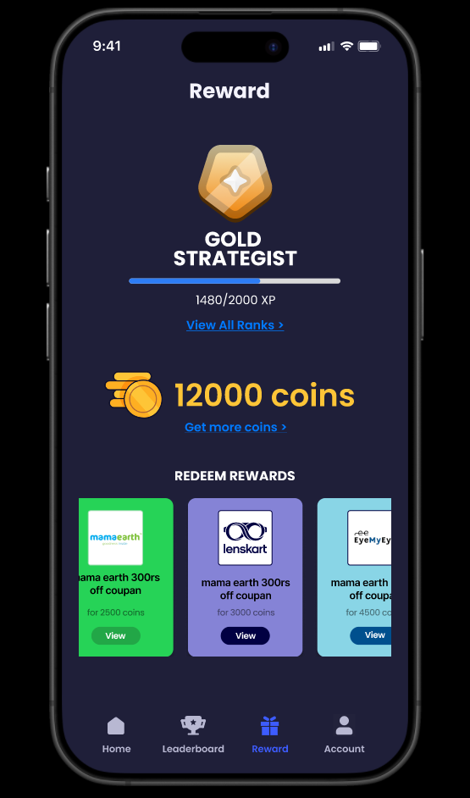
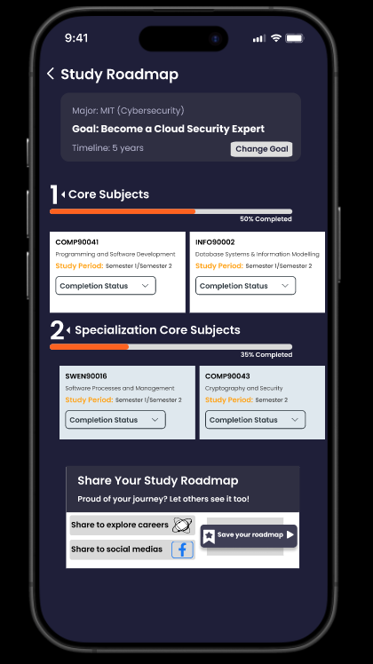
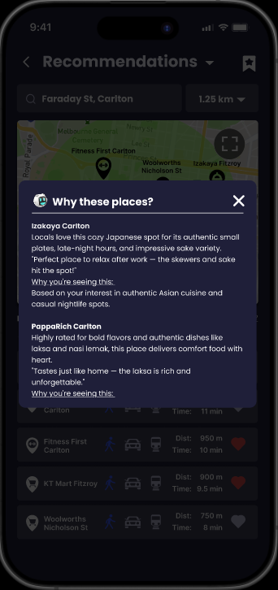
Hi! I am Melb AI!
UniConnect: Our Solution in Action and The Values it Delivers
Powered by gamification and informational system technologies
Gamification Engine – Foundational Technology
Insights Engine – AI Powered Informational System
UniConnect Main Systems
User Dashboard – Visual Dashboard with profile, trackable actions and achievements
Reward Centre – Redeem offers with collected coins
Study Roadmap – Recommends optimal subjects based on career goals and peer insights
Places Recommendations – Learns user preferences (distance, culture fit, prices) to suggest best-fit suburb
Rank-based status progression
Reward multiplier scheme based on rankings
Tiered achievement badges
Coin-based reward redemption
Delivers personalized experiences that adapts to students’ goals and context

Slide 5


UniConnect Feature 1: Our Solution in Action and The Values it Delivers
1
What it does?
Learn neighbourhoods by recommended hotspots, culture fit, price trends and student reviews.
Powered by a scoring algorithm and student feedback loop motivated by gamification
2
Values Proposition Feature 1 - Why UniConnect Adds Real Values
Suburb Insights
Efficiency
Saves hours of research time by aggregating suburb data into a digestible, side-by-side and seamless view
Decision Confidence
Students will feel empowered to choose their housing near campus that suits their cultural preferences, budget and lifestyle
Personalization over time
With more users interact with this app, the smarter the suburb recommendations become
Reduced Relocation Risk
Lower the chance of ending up in isolated areas by providing transparent, localized information before committing to a lease

Slide 6


UniConnect Feature 2: Our Solution in Action and The Values it Delivers
1
What it does?
Map-based interface to find real-time study groups based on students’ proximity and filter
XP points awarded for joining and hosting study groups
2
Values Proposition Feature 2 - Why UniConnect Adds Real Values
Group Finder
Engagement & Belonging
Helps student to overcome social isolation and connect through purposeful, low barrier academic environments
Academic Performance
Fosters motivation and through structured, peer-led group learning settings
Ease of Discovery
Reduced friction in finding or forming groups as students no longer depend on campus flyer or awkward forum posts
Inclusivity and Accessibility
Beneficial for introverted, late-enrolling students who struggle to make the first connection

Slide 7
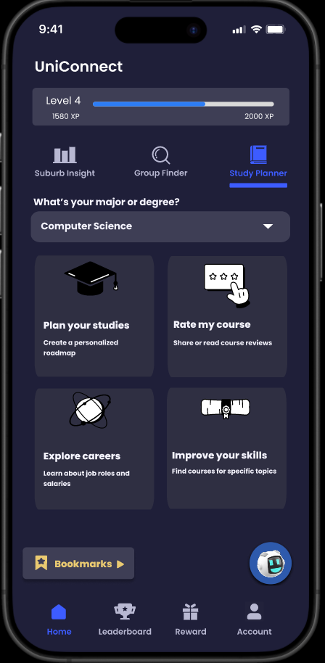



UniConnect Feature 3: Our Solution in Action and The Values it Delivers
1
What it does?
Generate tailored study roadmap based on user-selected degree, interest and career pathways
Connect aspirations to real-world roles and industry salary benchmarks
XP points awarded for rating courses and sharing roadmap milestones.
2
Values Proposition Feature 3 - Why UniConnect Adds Real Values
Study Planner
Clarity and Direction
Helps to navigate degree complexity and build confidence in their course completion and career aspirations
Career Alignment
Build a bridge between academia and industry contexts. Every study decision is mapped to future roles and real skills
Self Reflection and Planning
Encourage students to proactively think around future pathways, enabling better subject selections and productivity
Peer Insights
Gives access to student-rated course feedback and popular learning path. Reduces risk in course selection

Slide 8

UniConnect:
Smarter Study.
Stronger Support.
All the basic needs for international students – powered by AI, delivered in one app.
Helping international student succeed through:
P Transparent quality suburb data
P Convenient group collaboration
P Efficient study planning
Start your smarter study journey with UniConnect.
Developed by Group E – INFO90010 Technology Innovation Project

